Slide 1
We Are Together
Brave Together’s New Collaboration Platform

Slide 2
Problem
Connecting and managing
volunteers in collaboration projects

Slide 3
Solution
Digital project platform
Connecting between volunteers for high quality projects

Slide 4
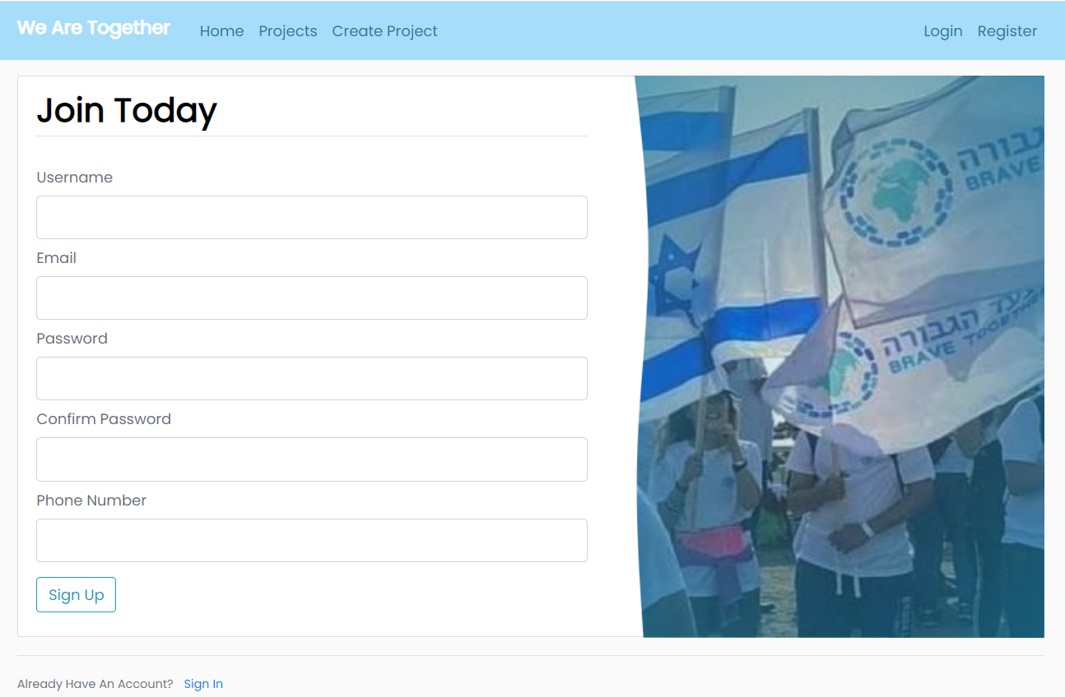
Platform

Slide 5
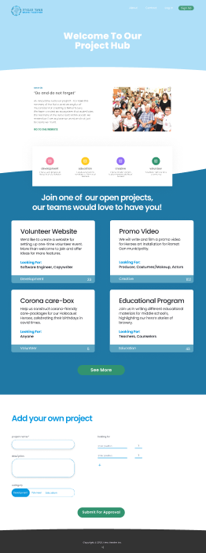
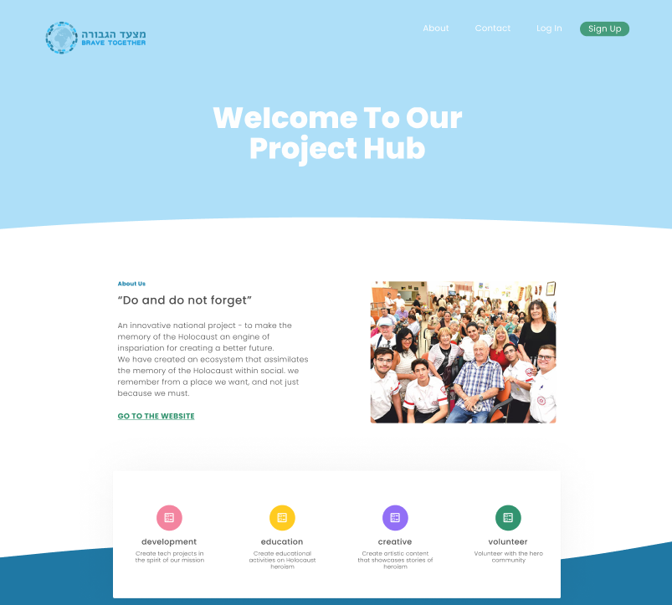
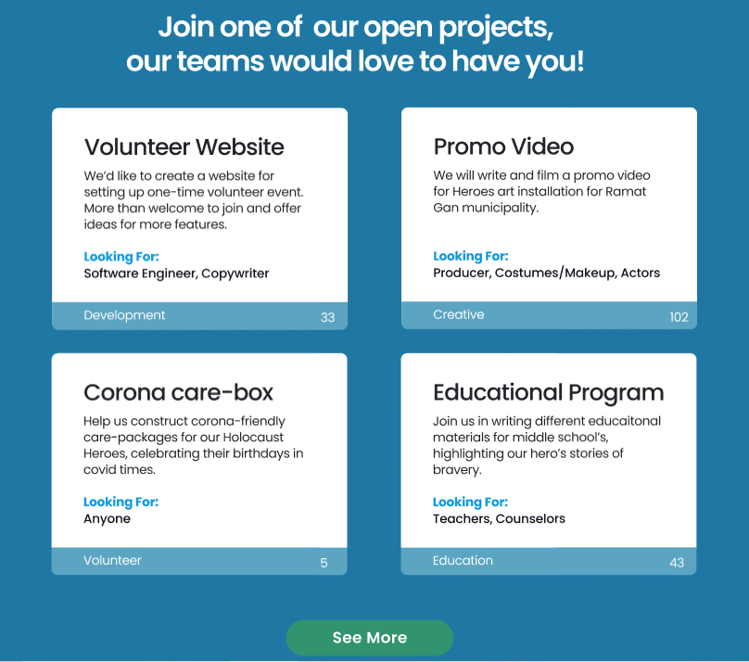
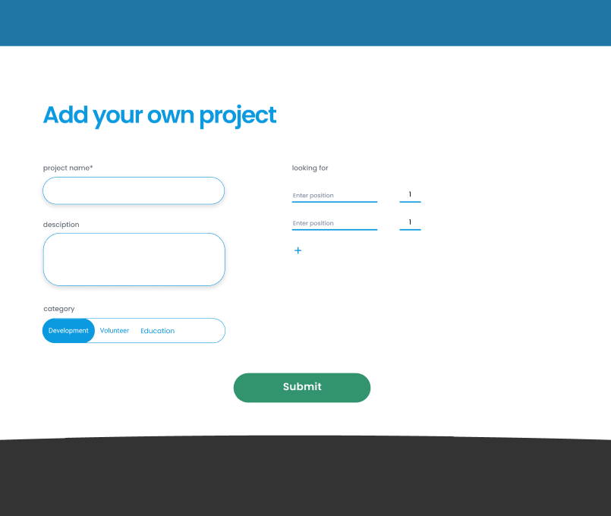
Platform

Slide 6



Added Value
Matching volunteers to projects
Higher quality projects
Simplifies project overseeing for Brave Together

Slide 7





MVP
Web platform
4 categories
Joining projects
Database
User Registration

Slide 8
Roadmap
Timeline Templates
Expanding Project Managers Toolbox
Expanding Brave Togethers accompaniment
Search and Sorting

Slide 9
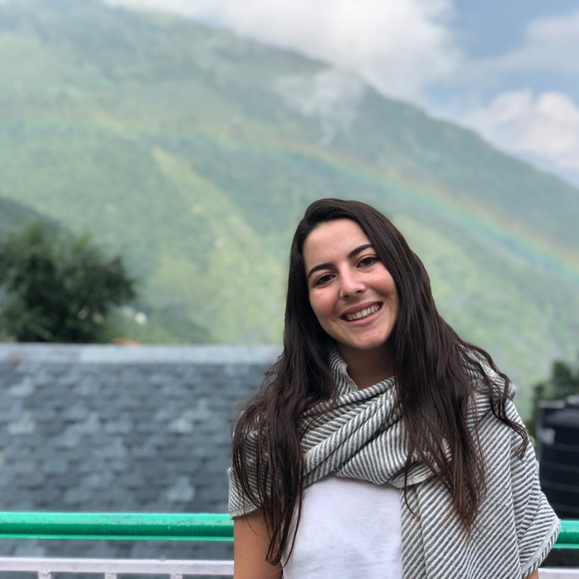
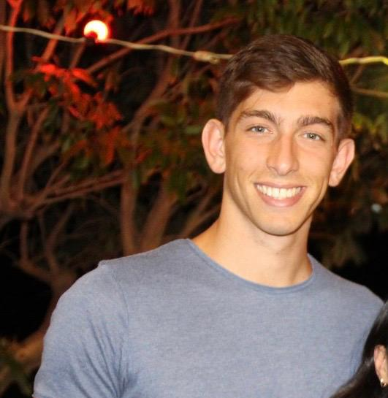
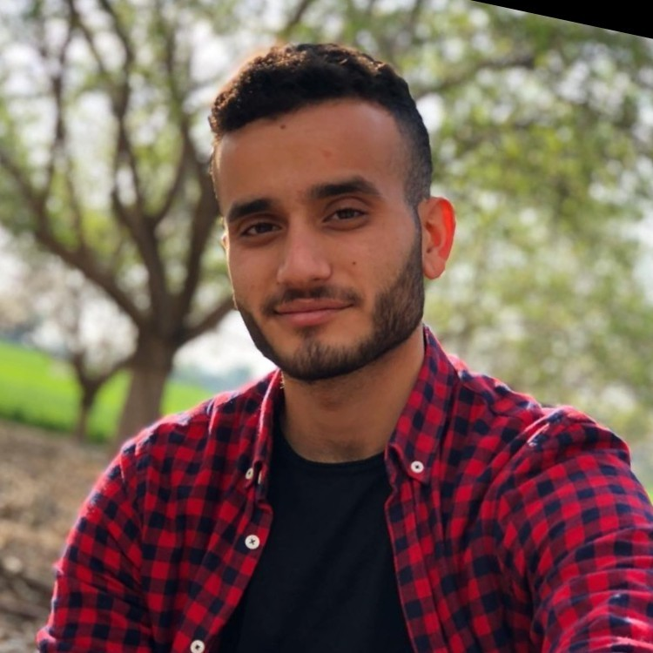
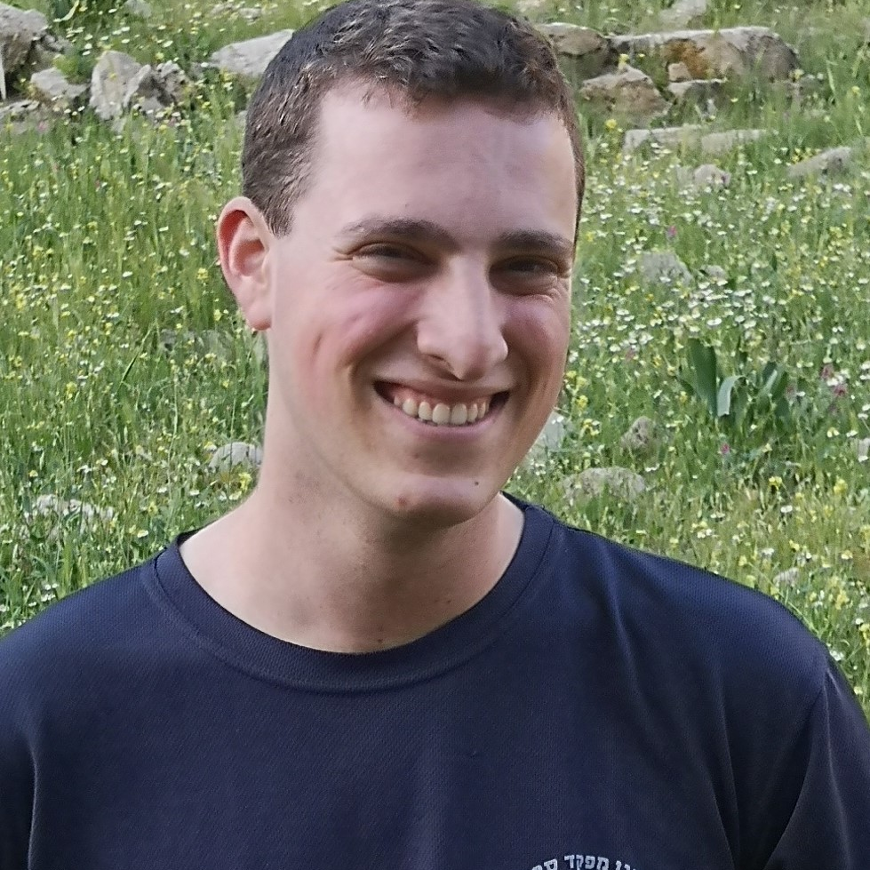
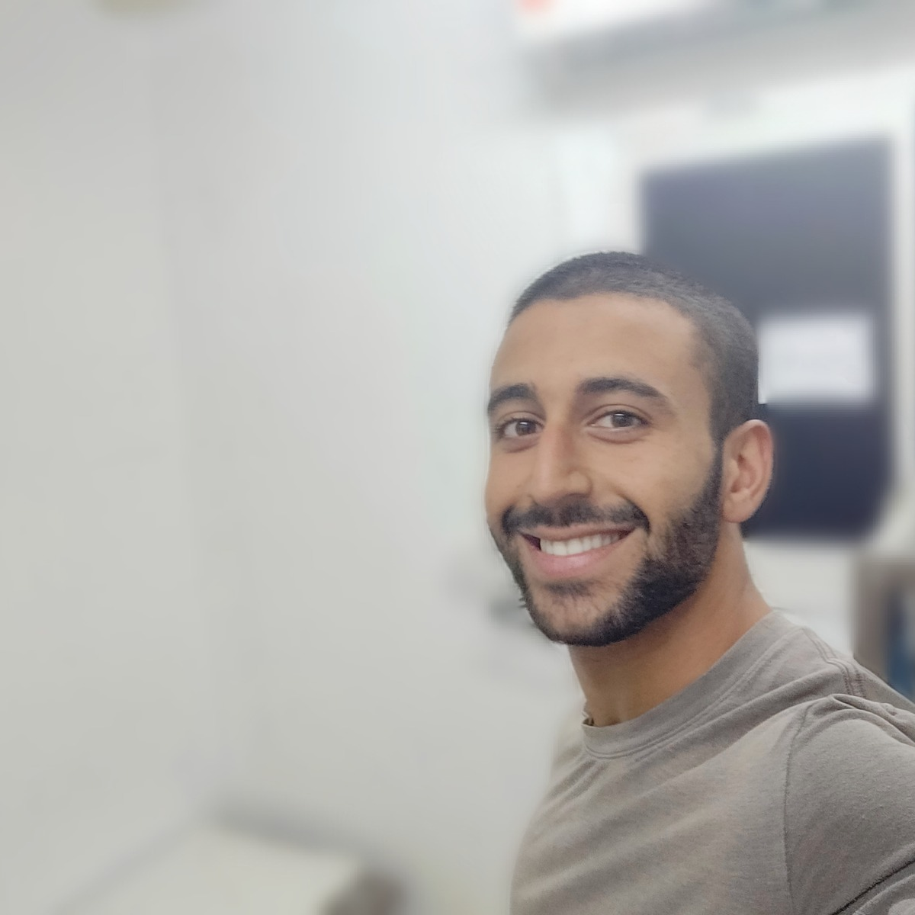
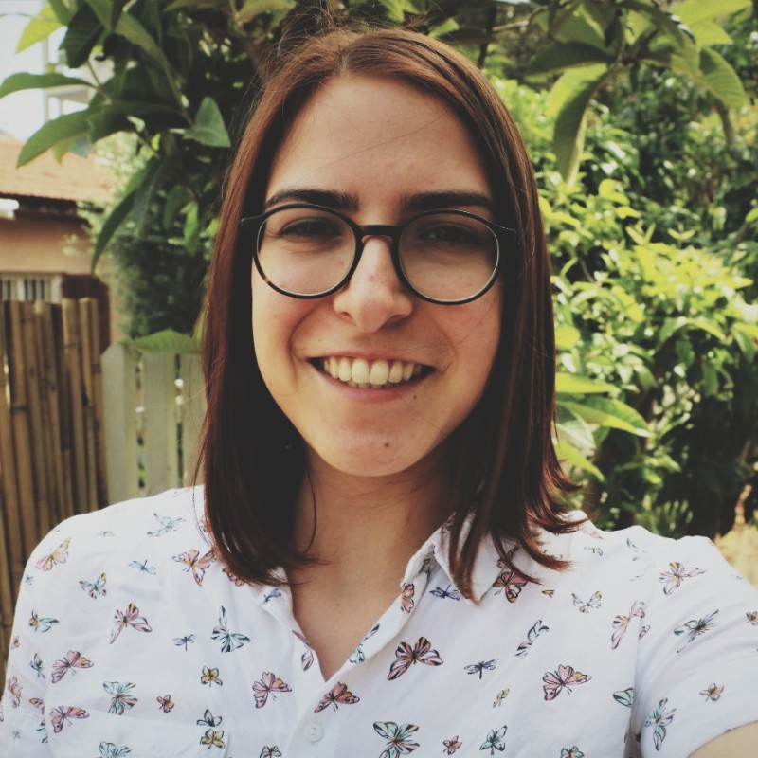
THE TEAM
Yuval Toledano
Tomer Gillmore
Dor Probstein
Netzer Epstein
Dolev Hacohen
Shelly Ben-Dor

Slide 10
Thank You!

